Slide 1
Deep Learning for Natural Language Processing Lecture 1: Logistics Regression for Text Classification
Quan Thanh Tho
Faculty of Computer Science and Engineering
Back Khoa University

Slide 2
Acknowledgement
Some slides are from Coursera course of Prof. Andew Ng.

Slide 3
Agenda
Classical Machine Learning Techniques for NLP
Neural-based Roadmap of NLP
Logistics Regression for Text Classification
Demonstration and Assignment

Slide 4
Classical Machine Learning Techniques for NLP
Machine Learning Task
The tf.idf weights
Neural-based approach

Slide 5
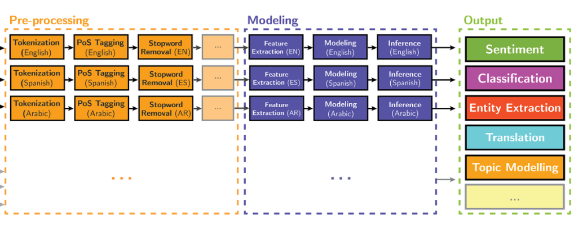

Slide 6
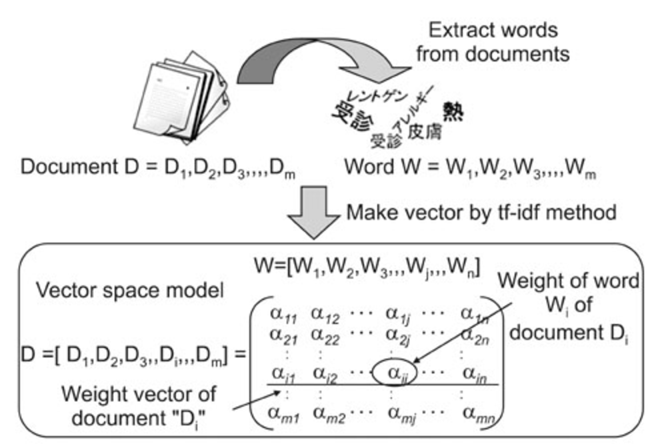

Slide 7
Document Collection
A collection of n documents can be represented in the vector space model by a term-document matrix.
An entry in the matrix corresponds to the “weight” of a term in the document; zero means the term has no significance in the document or it simply doesn’t exist in the document.
T₁ T₂ …. T_{t}
D₁ w₁₁ w₂₁ … w_{t1}
D₂ w₁₂ w₂₂ … w_{t2}
: : : :
: : : :
D_{n} w_{1n} w_{2n} … w_{tn}

Slide 8
Term Weights: Term Frequency
More frequent terms in a document are more important, i.e. more indicative of the topic.
f_{ij} = frequency of term i in document j
May want to normalize term frequency (tf) by dividing by the frequency of the most common term in the document:
tf_{ij} = f_{ij} / max_{i}{f_{ij}}

Slide 9
Term Weights: Inverse Document Frequency
Terms that appear in many different documents are less indicative of overall topic.
df _{i} = document frequency of term i
= number of documents containing term i
idf_{i} = inverse document frequency of term i,
= log₂ (N/ df _{i})
(N: total number of documents)
An indication of a term’s discrimination power.
Log used to dampen the effect relative to tf.

Slide 10
TF-IDF Weighting
A typical combined term importance indicator is tf-idf weighting:
w_{ij} = tf_{ij} idf_{i} = tf_{ij} log₂ (N/ df_{i})
A term occurring frequently in the document but rarely in the rest of the collection is given high weight.
Many other ways of determining term weights have been proposed.
Experimentally, tf-idf has been found to work well.

Slide 11
Computing TF-IDF -- An Example
Given a document containing terms with given frequencies:
A(3), B(2), C(1)
Assume collection contains 10,000 documents and
document frequencies of these terms are:
A(50), B(1300), C(250)
Then:
A: tf = 3/3; idf = log₂(10000/50) = 7.6; tf-idf = 7.6
B: tf = 2/3; idf = log₂ (10000/1300) = 2.9; tf-idf = 2.0
C: tf = 1/3; idf = log₂ (10000/250) = 5.3; tf-idf = 1.8

Slide 12
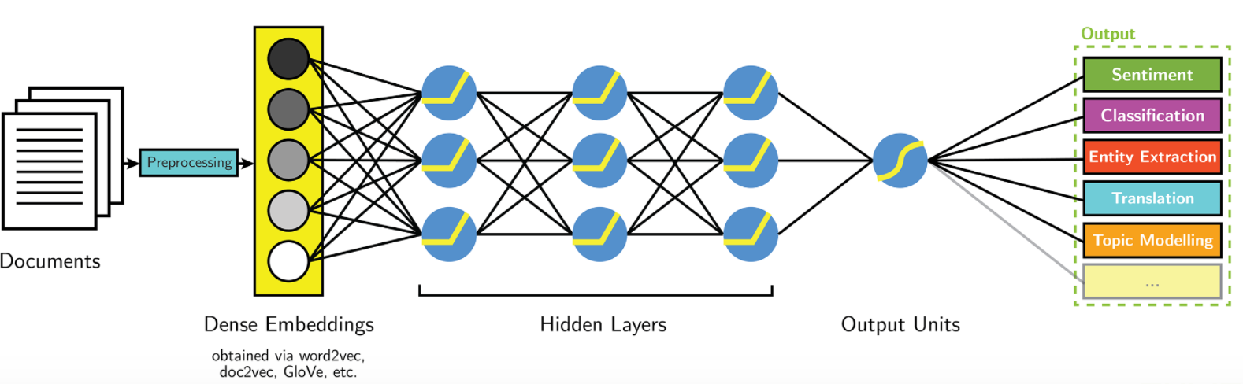
Neural-based Approaches

Slide 13
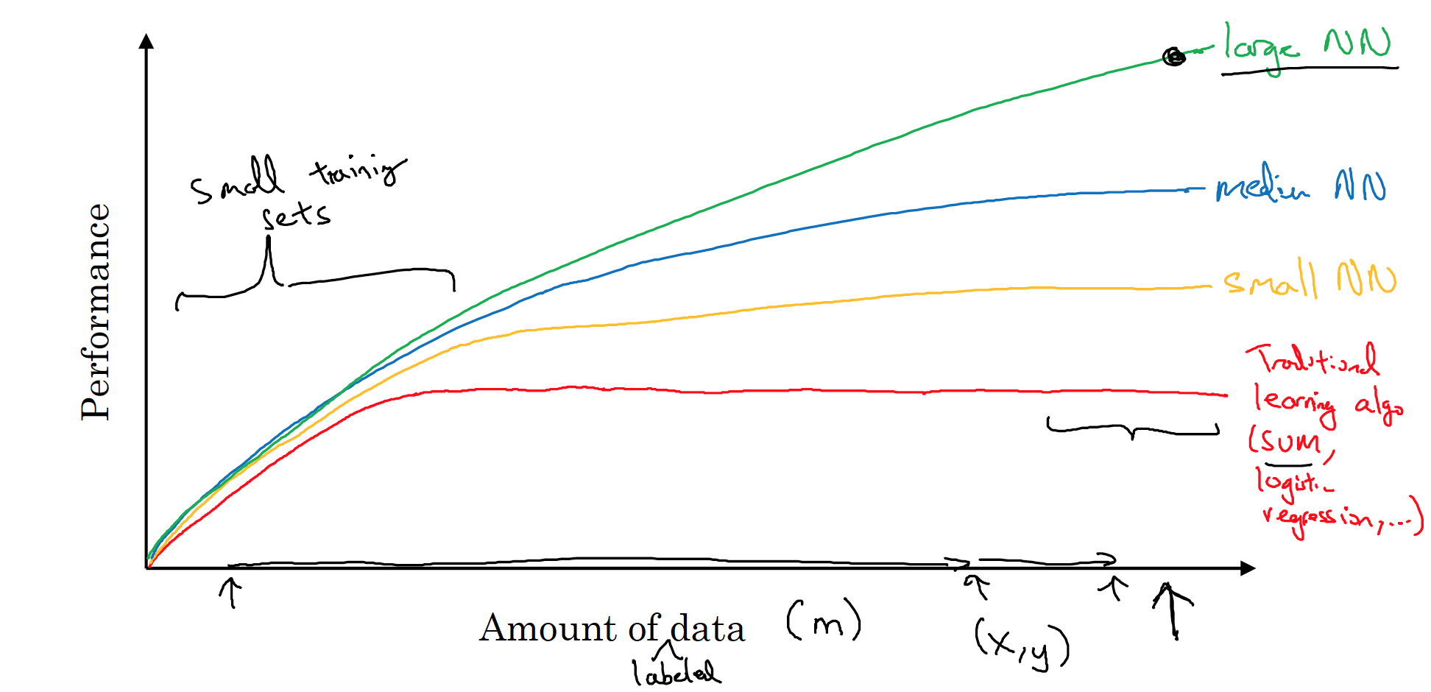
Why Neural?

Slide 14
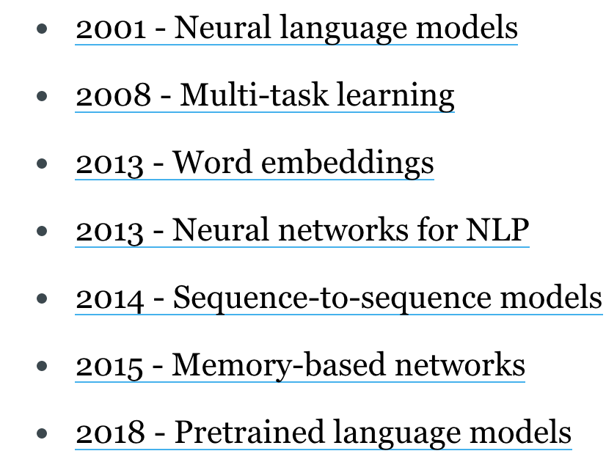
Neural-based Milestones for NLP
Character-based representations
Adversarial learning
Reinforcement learning
Conditional random fields
Bleu
Latent Dirichlet Allocation
Wikipedia exploitation

Slide 15
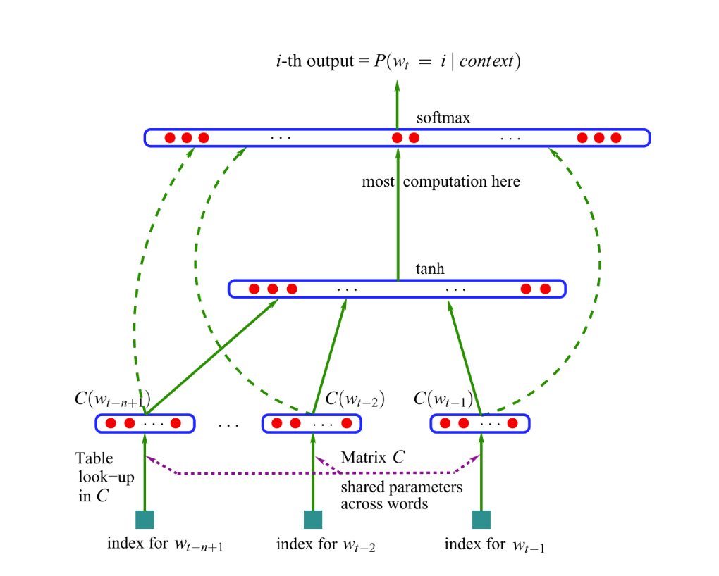
Neural Language Model

Slide 16
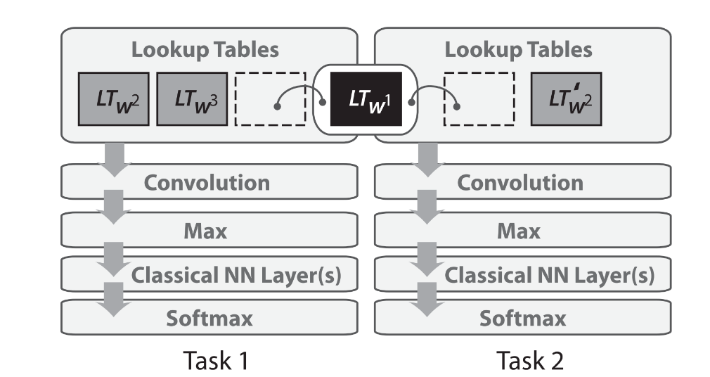
Multitask Learning

Slide 17
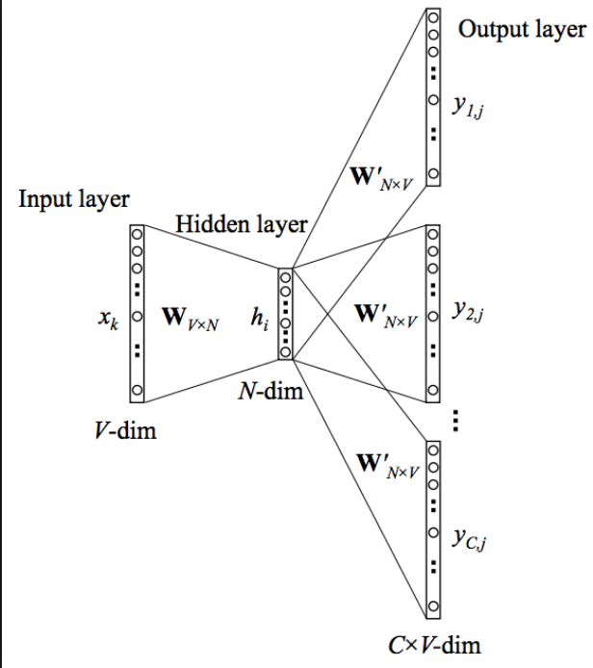
Word Embedding

Slide 18
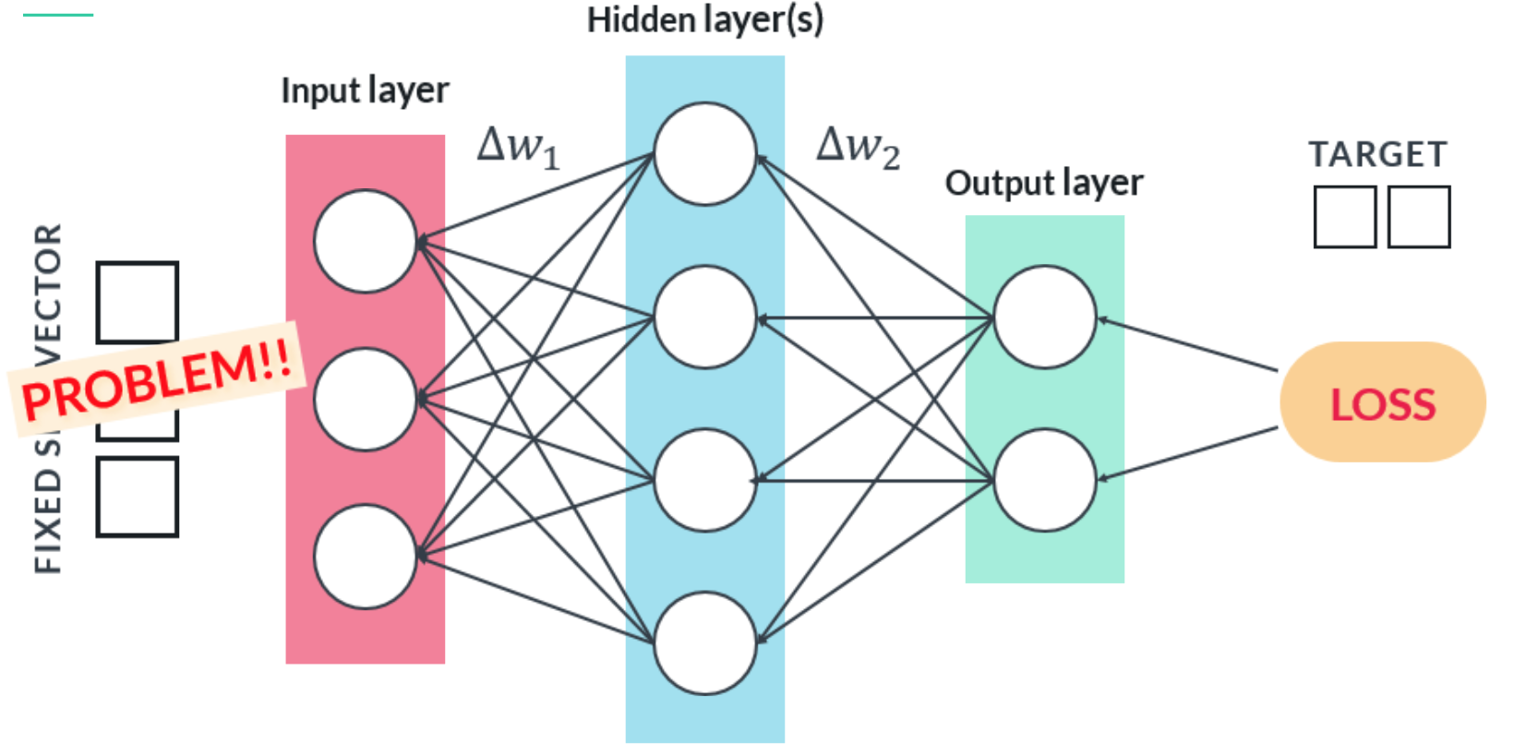

Slide 19
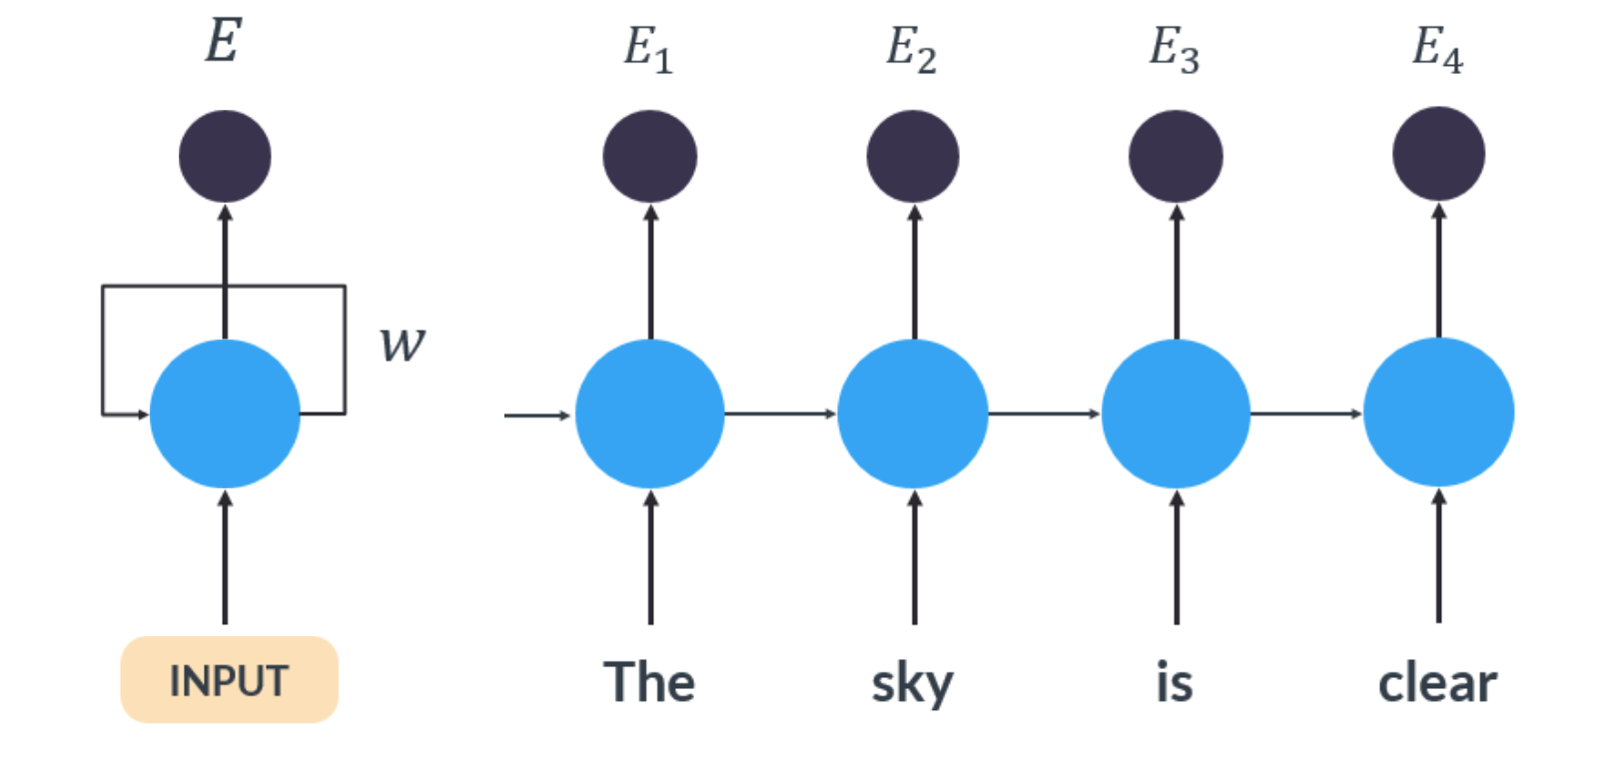
Recurrent Neural Networks

Slide 20
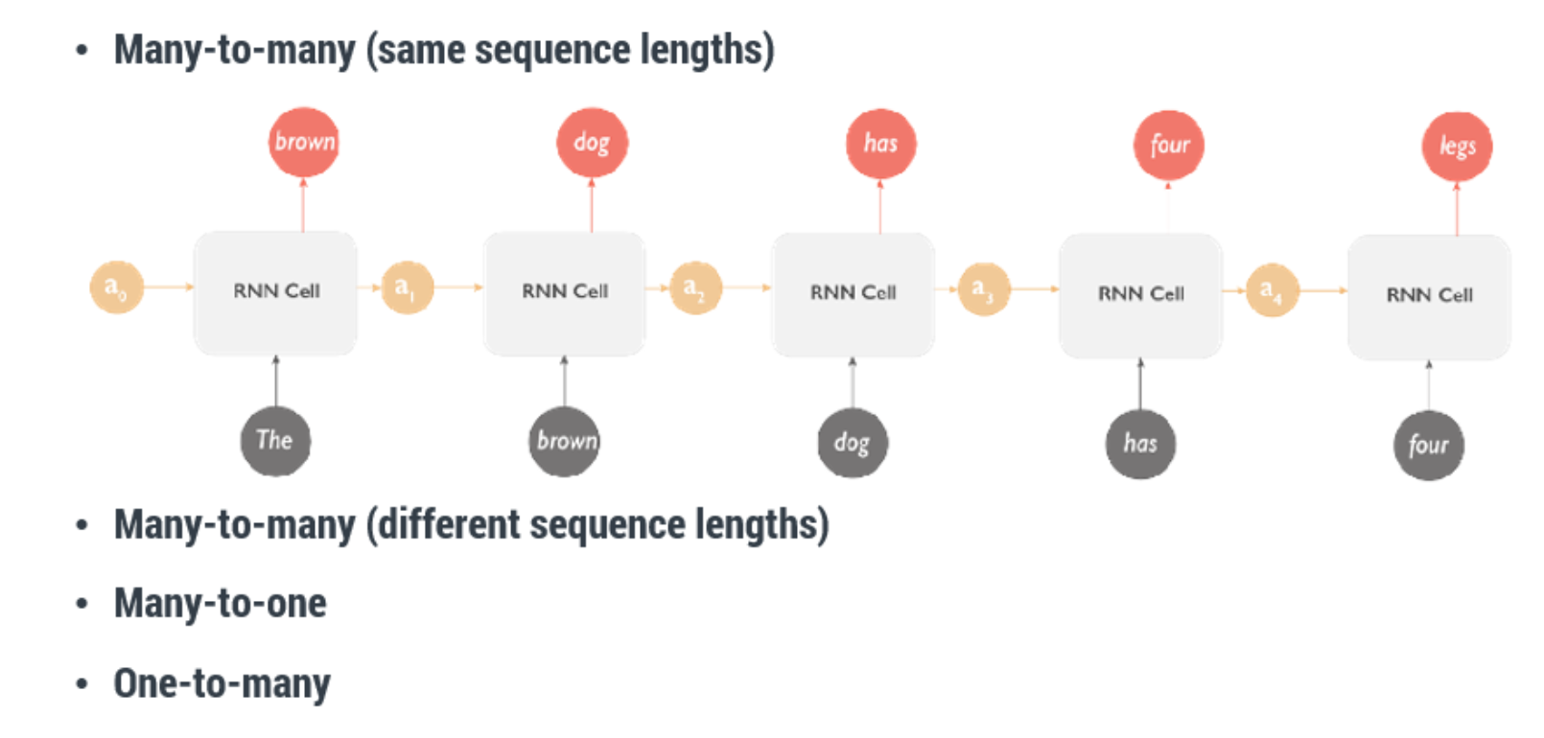
RNN Common Architectures

Slide 21
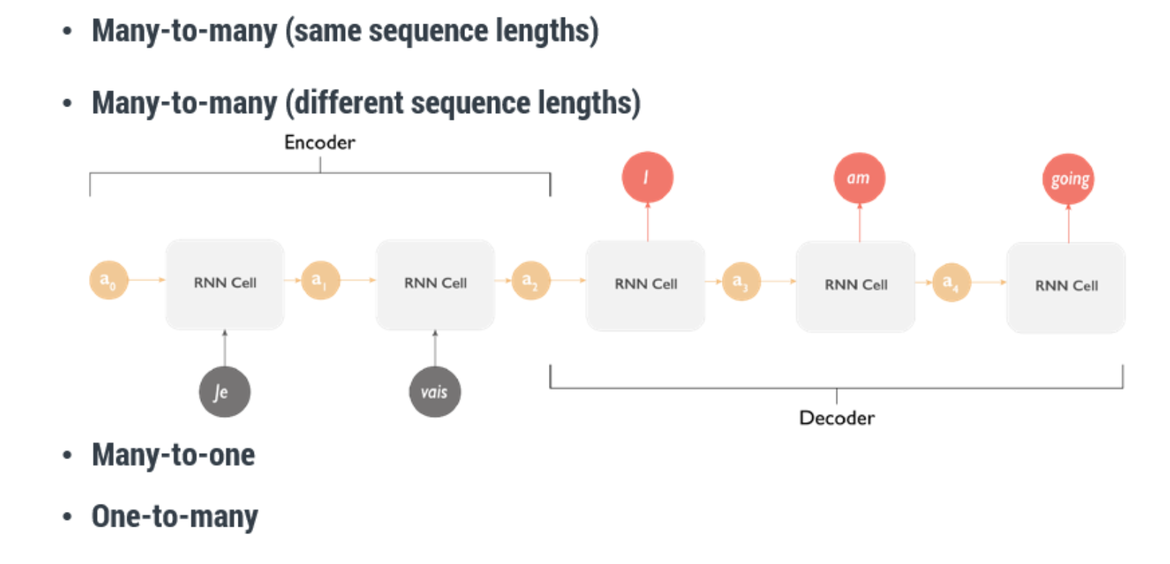
RNN Common Architectures

Slide 22
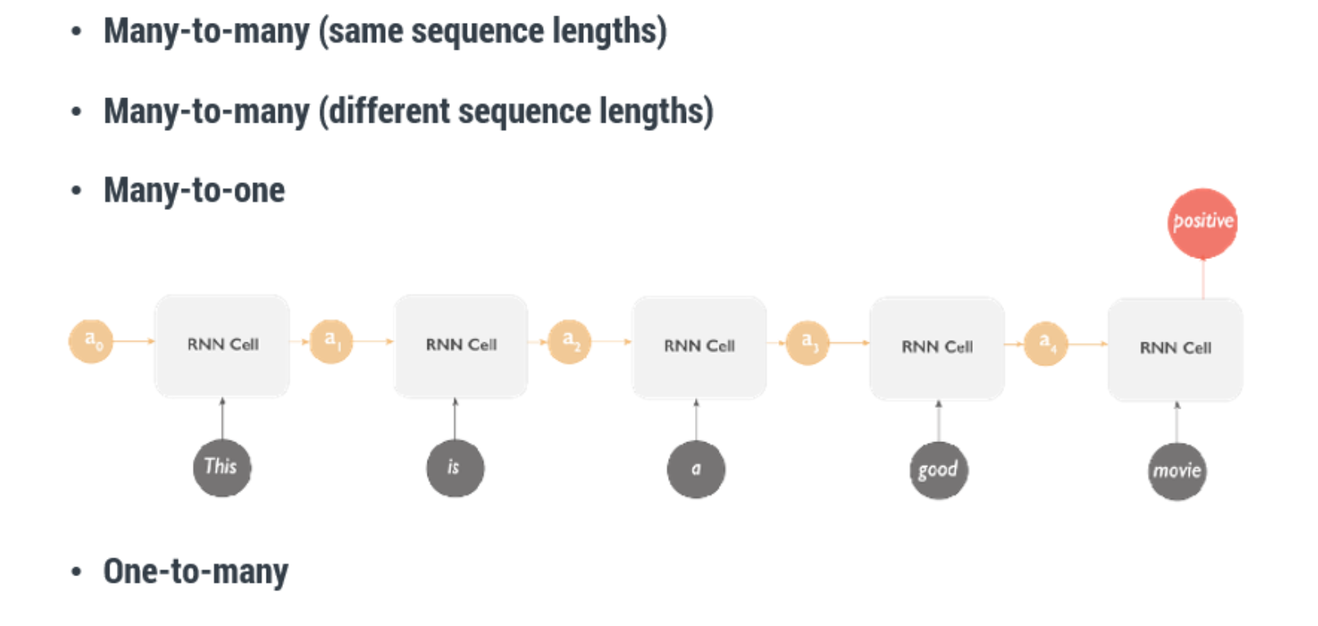
RNN Common Architectures

Slide 23
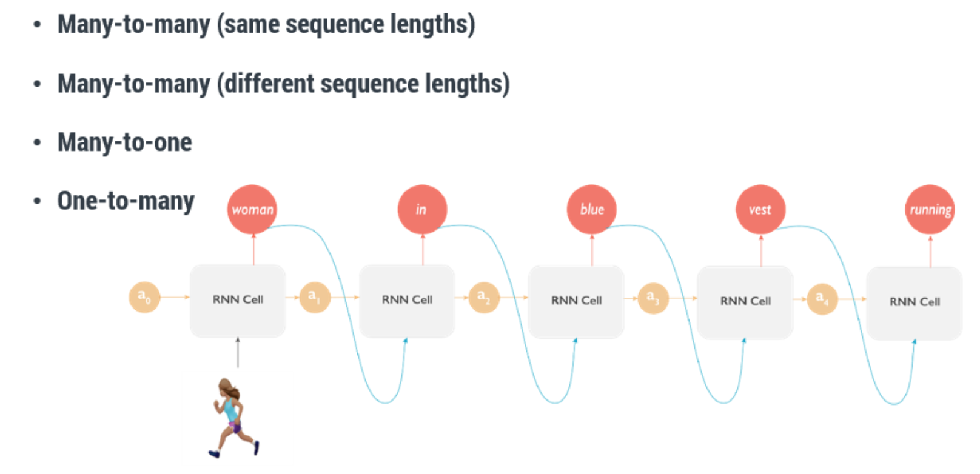
RNN Common Architectures

Slide 24
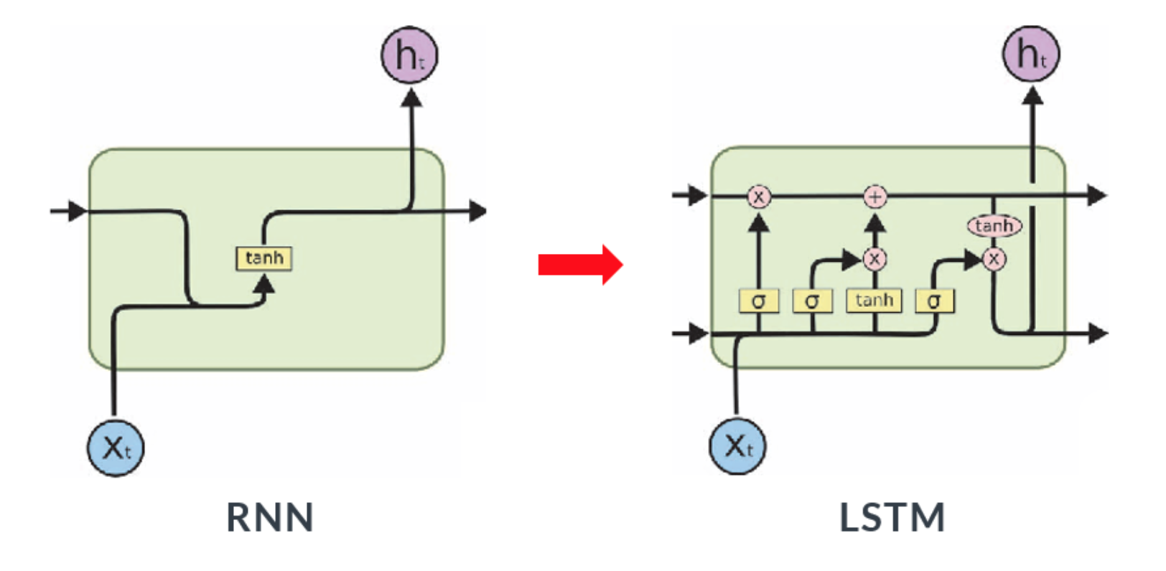
Enhancement from RNN

Slide 25
Enhancement from RNN

Slide 26
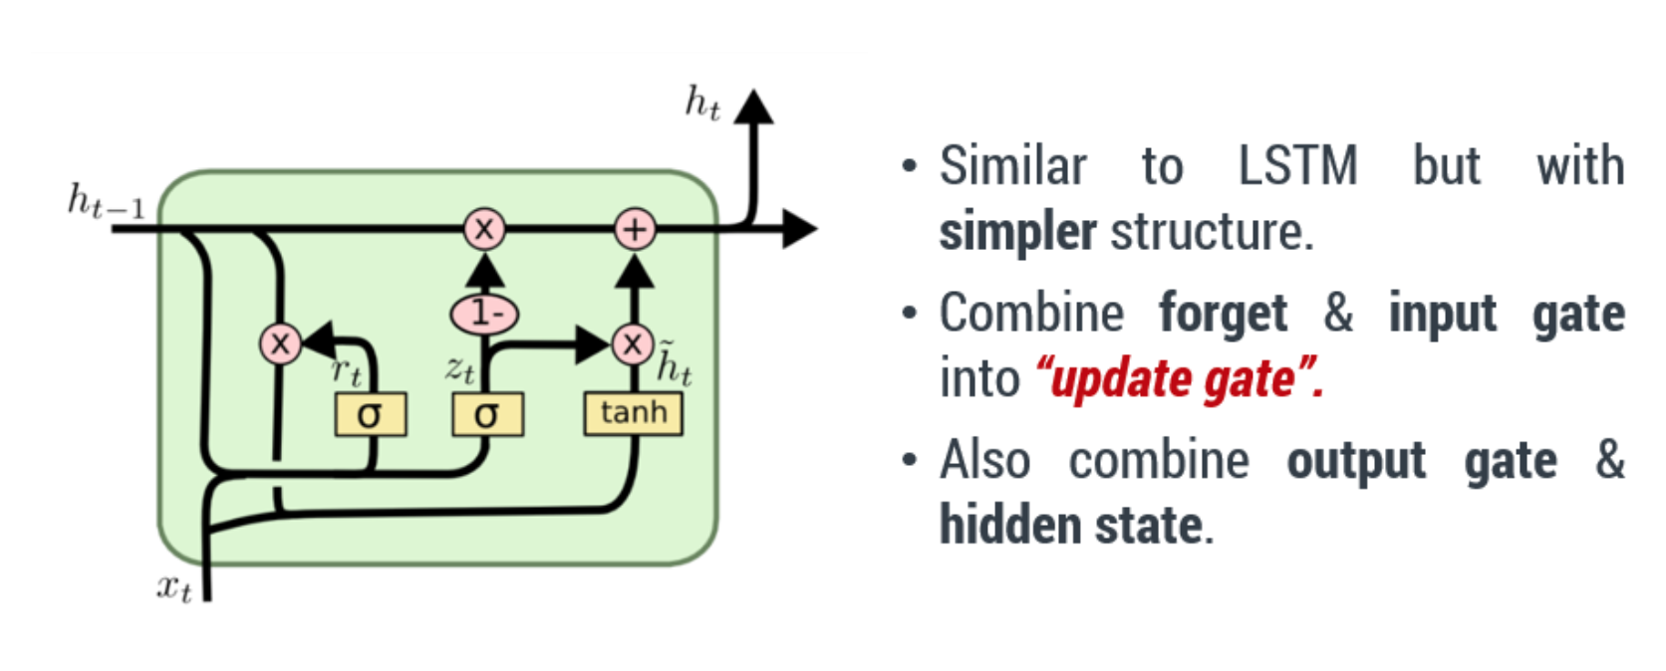
Gated Recurrent Unit

Slide 27
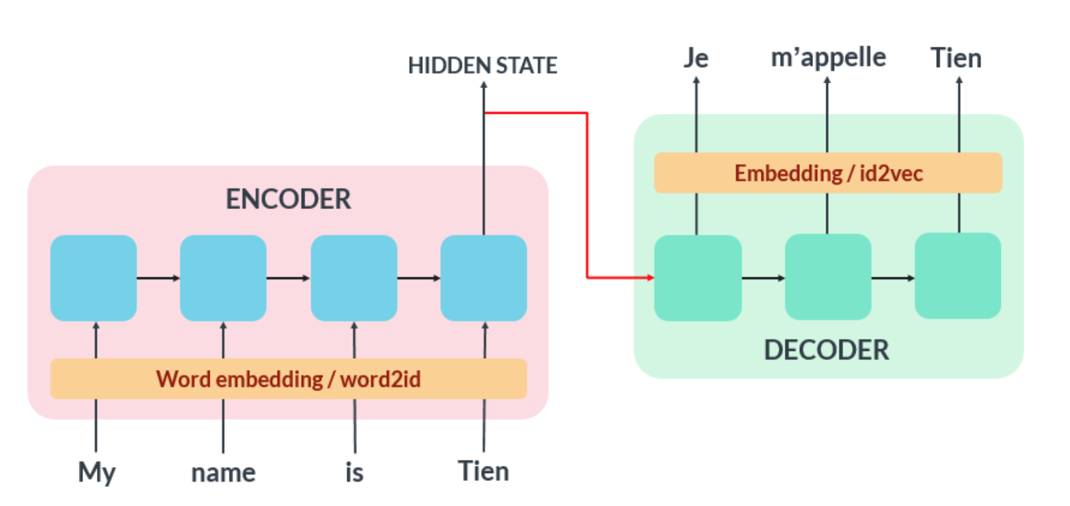
Seq2seq Architecture

Slide 28
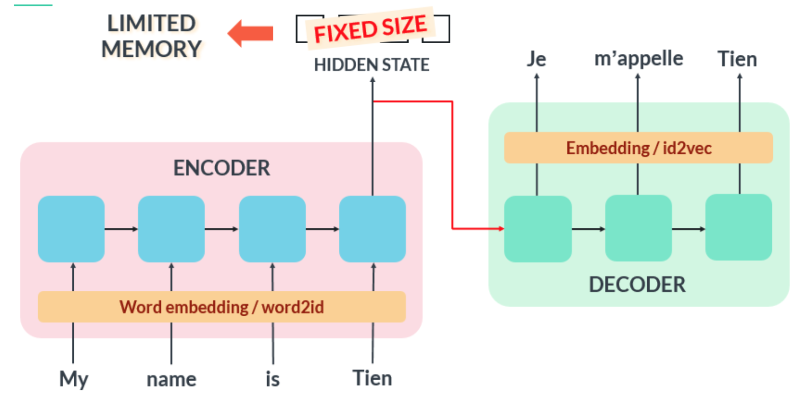
Seq2seq limitation

Slide 29
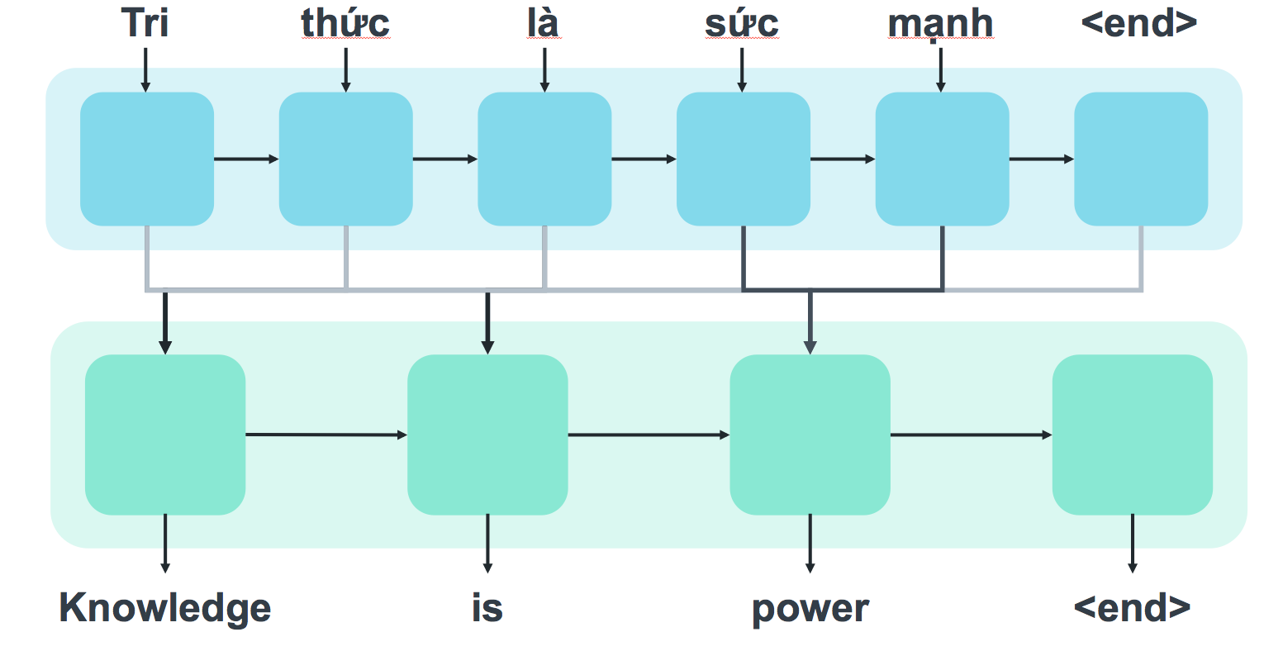
Attention Mechanism

Slide 30
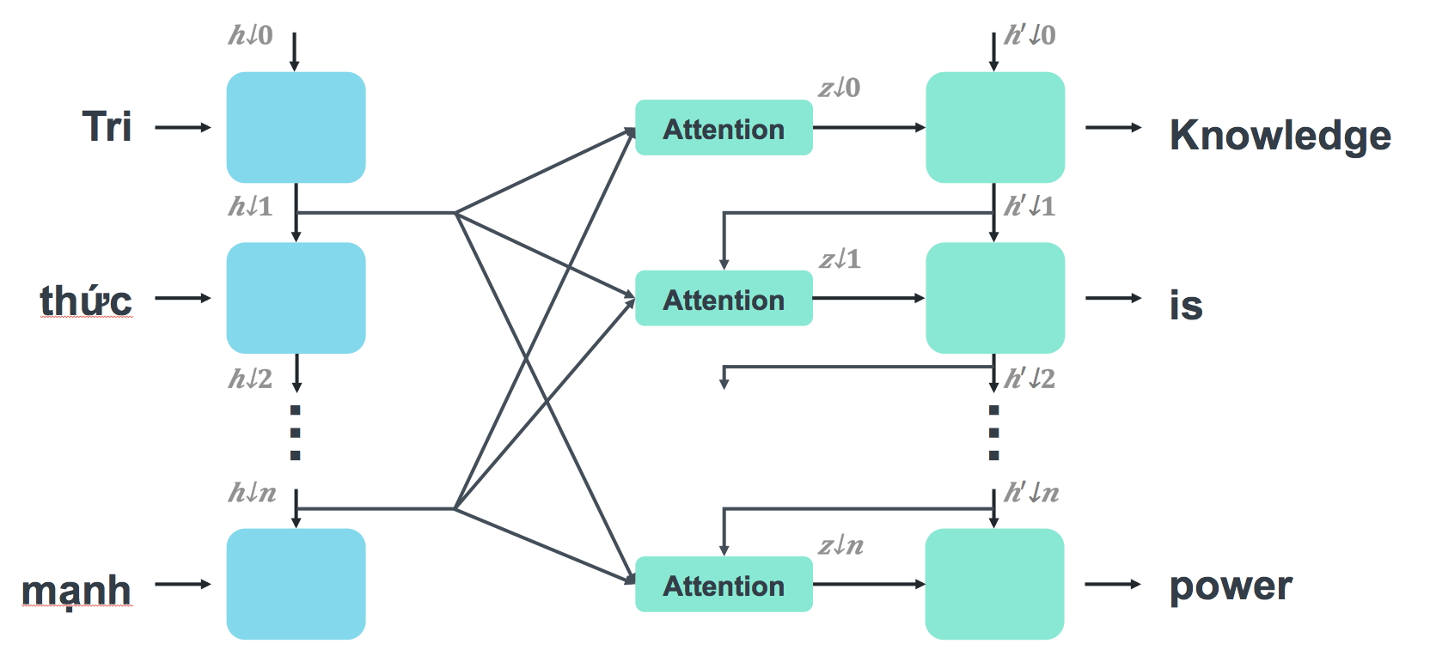
Attention Mechanism

Slide 31
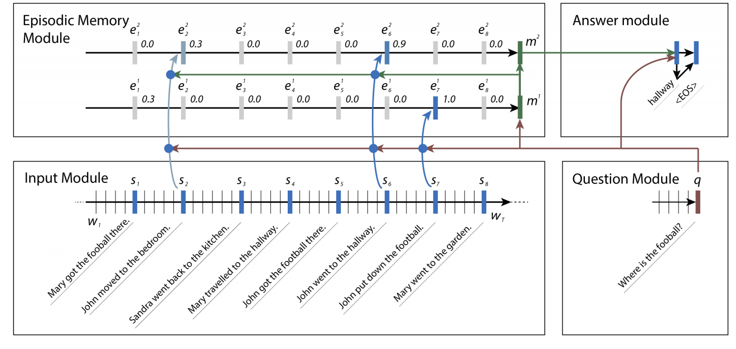
Dynamic Memory Model

Slide 32
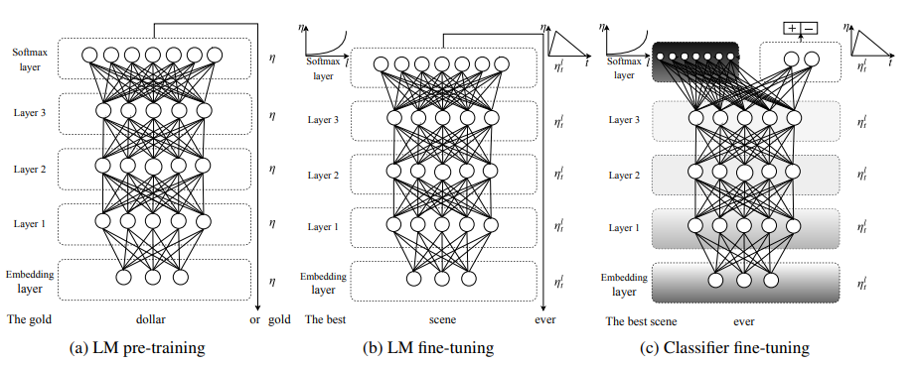
Pre-trained Language Model

Slide 33
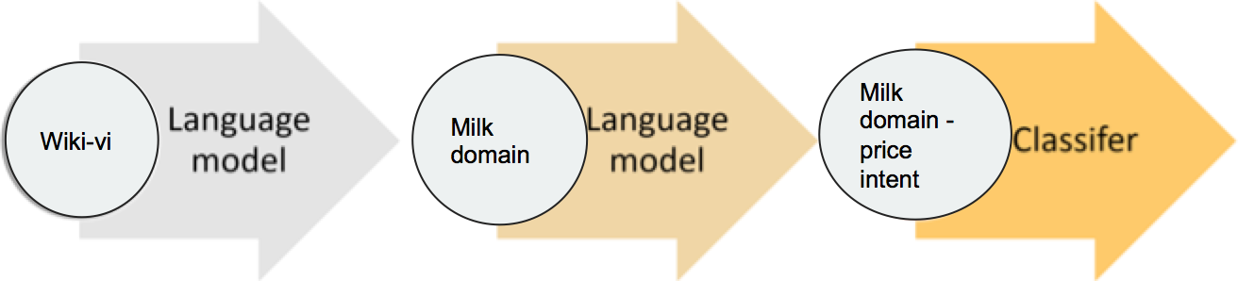
Pre-trained Neural Language Model

Slide 34
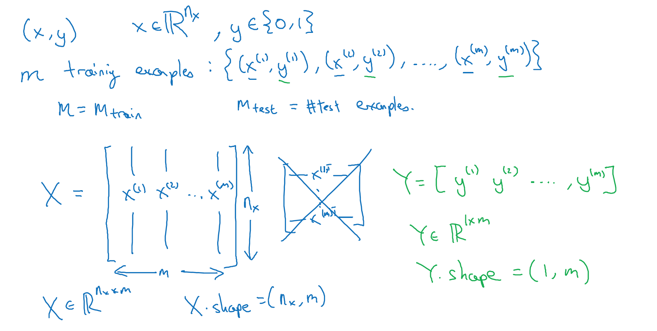
Supervised Learning Problem

Slide 35
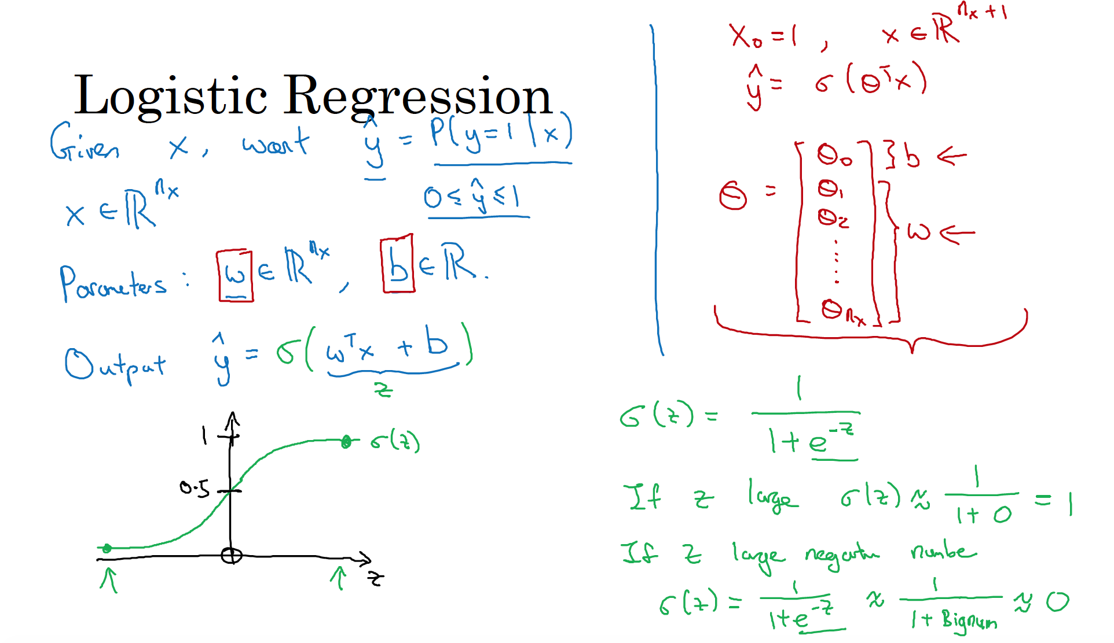

Slide 36
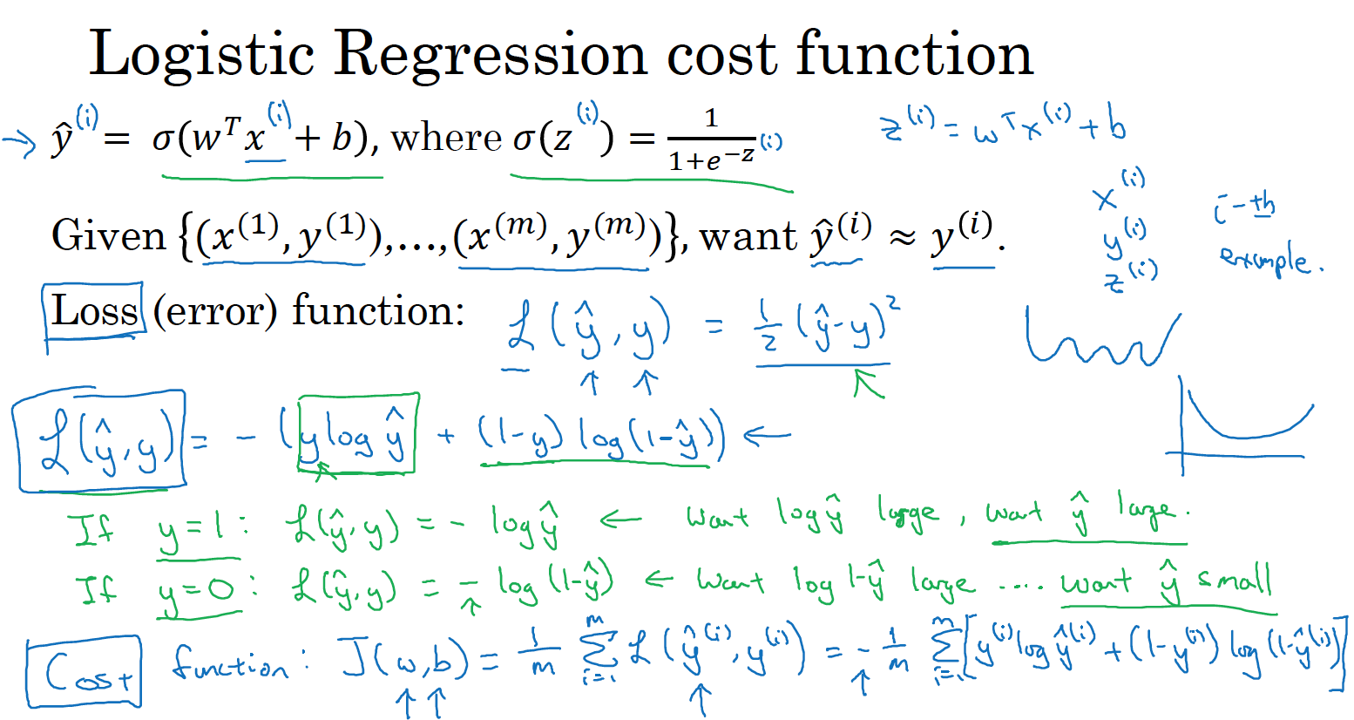

Slide 37
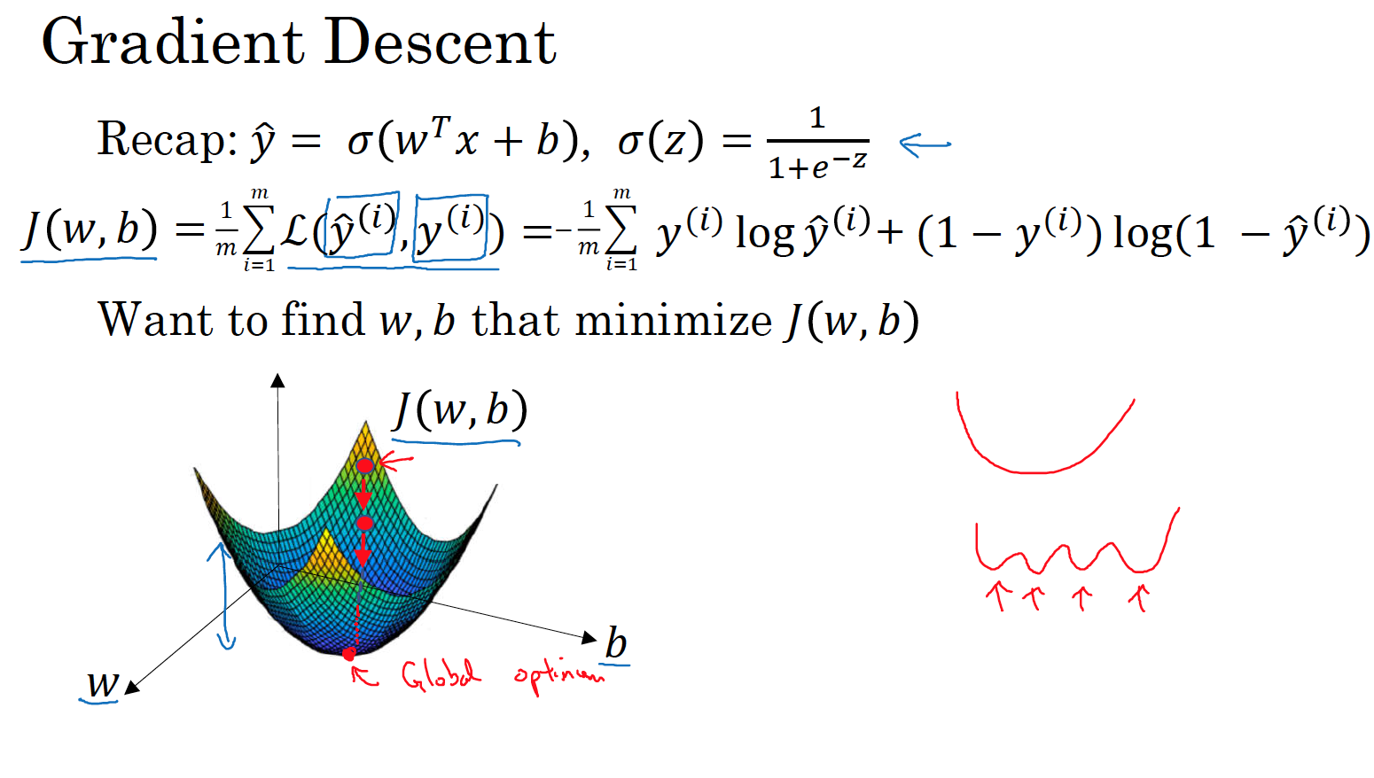

Slide 38
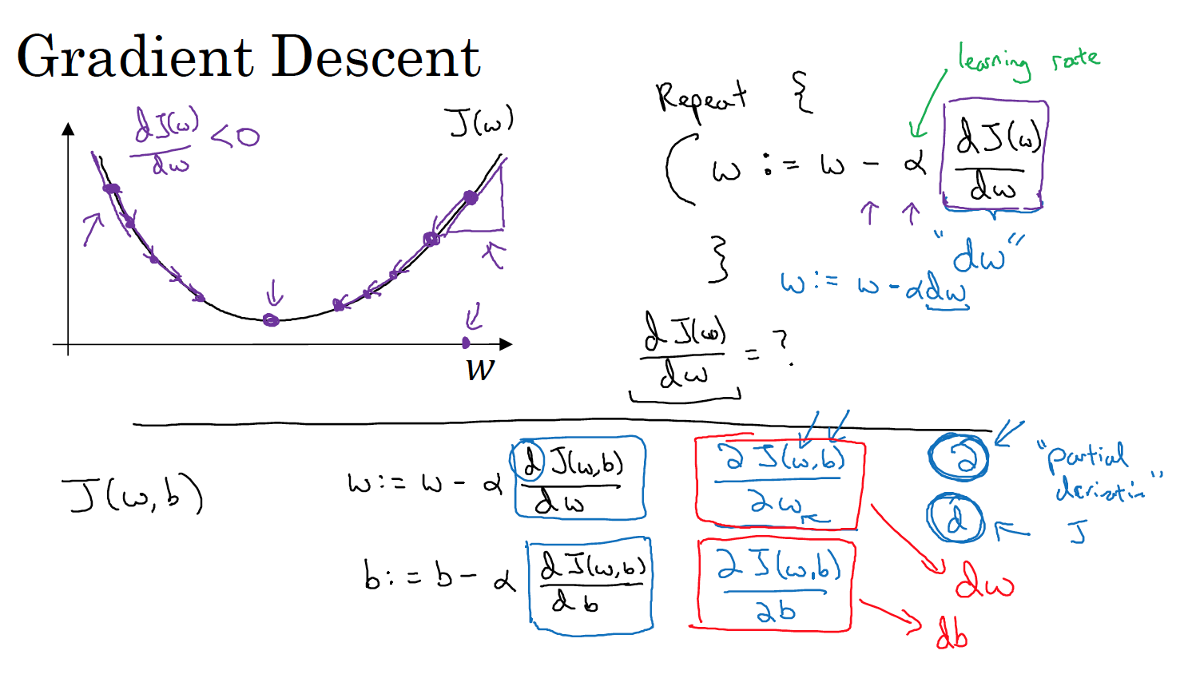

Slide 39
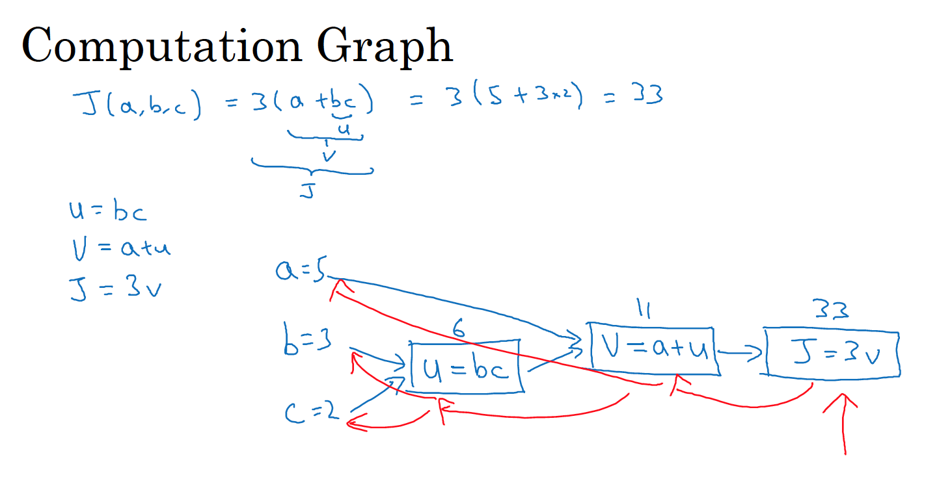

Slide 40
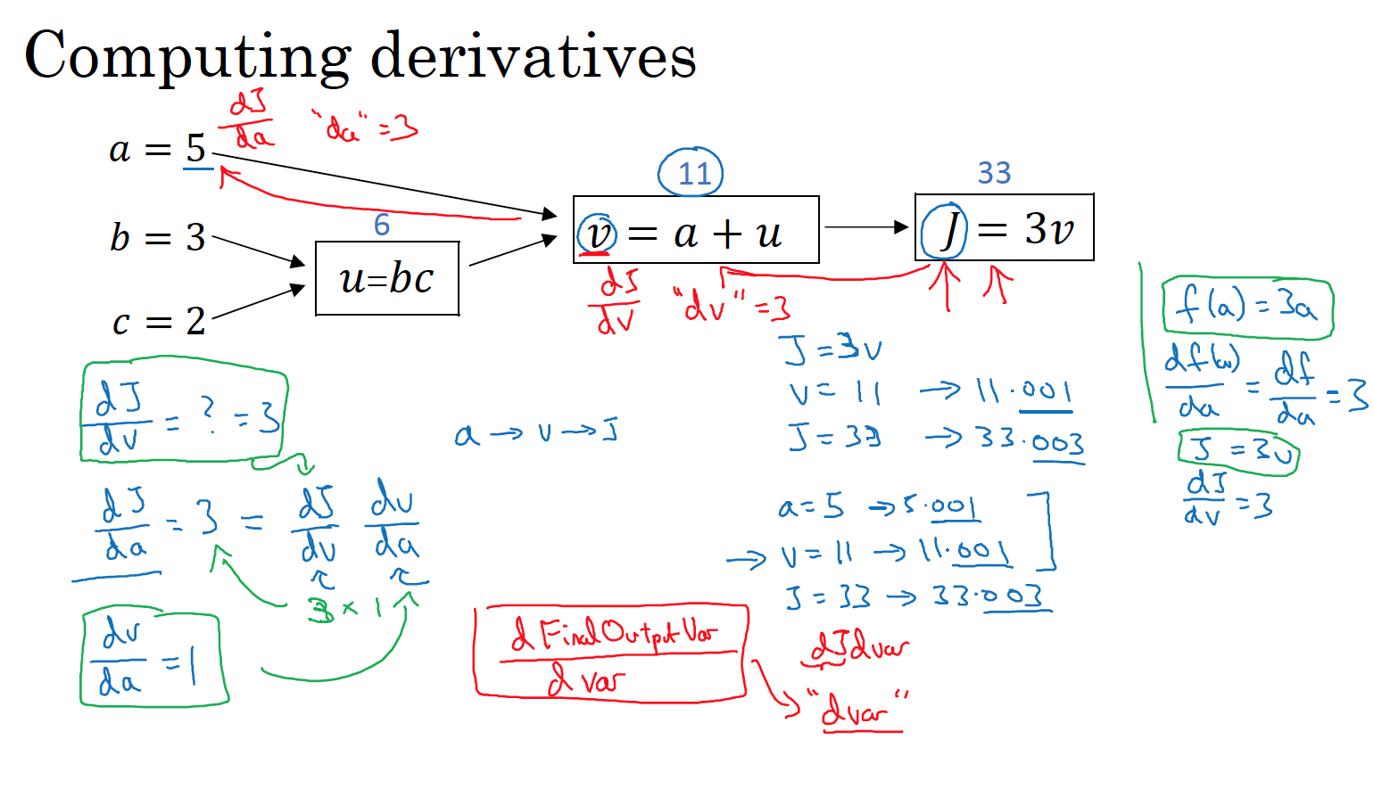

Slide 41
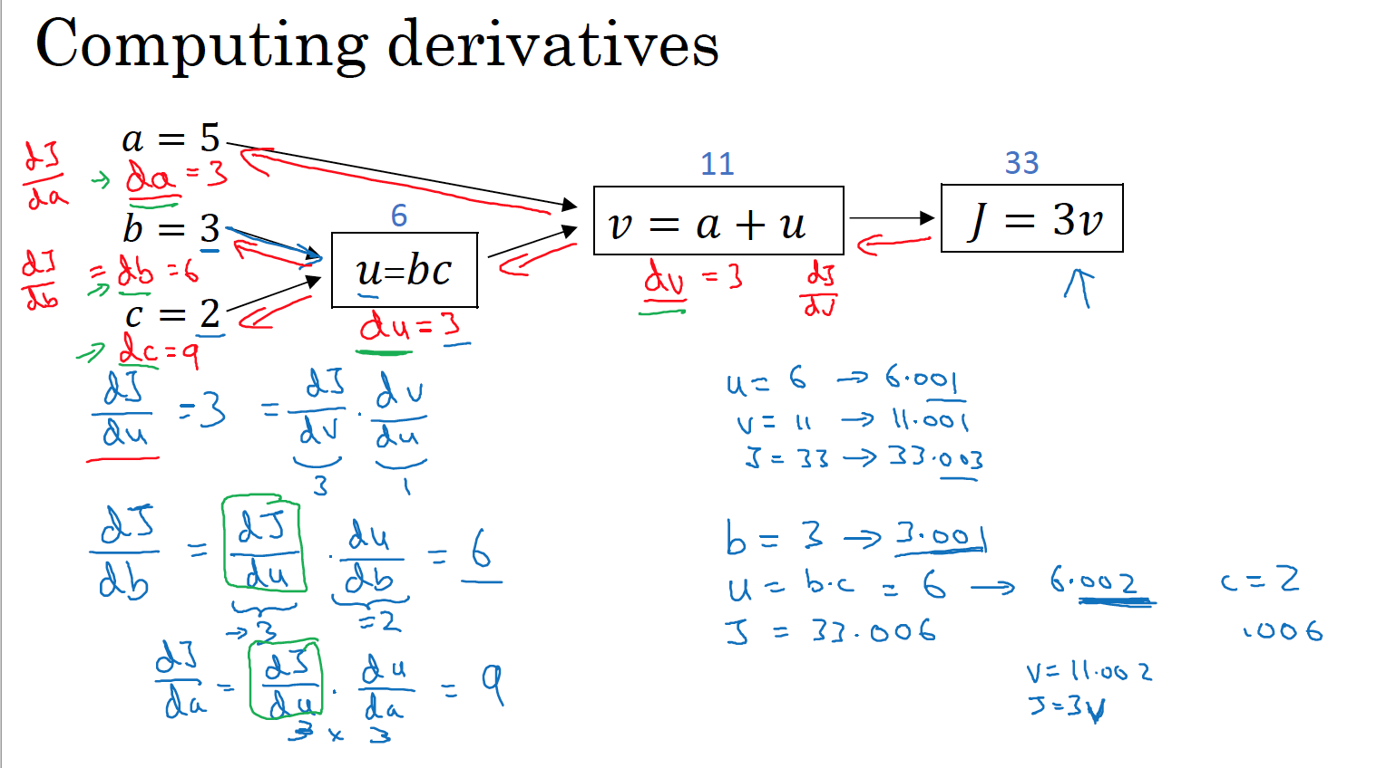

Slide 42
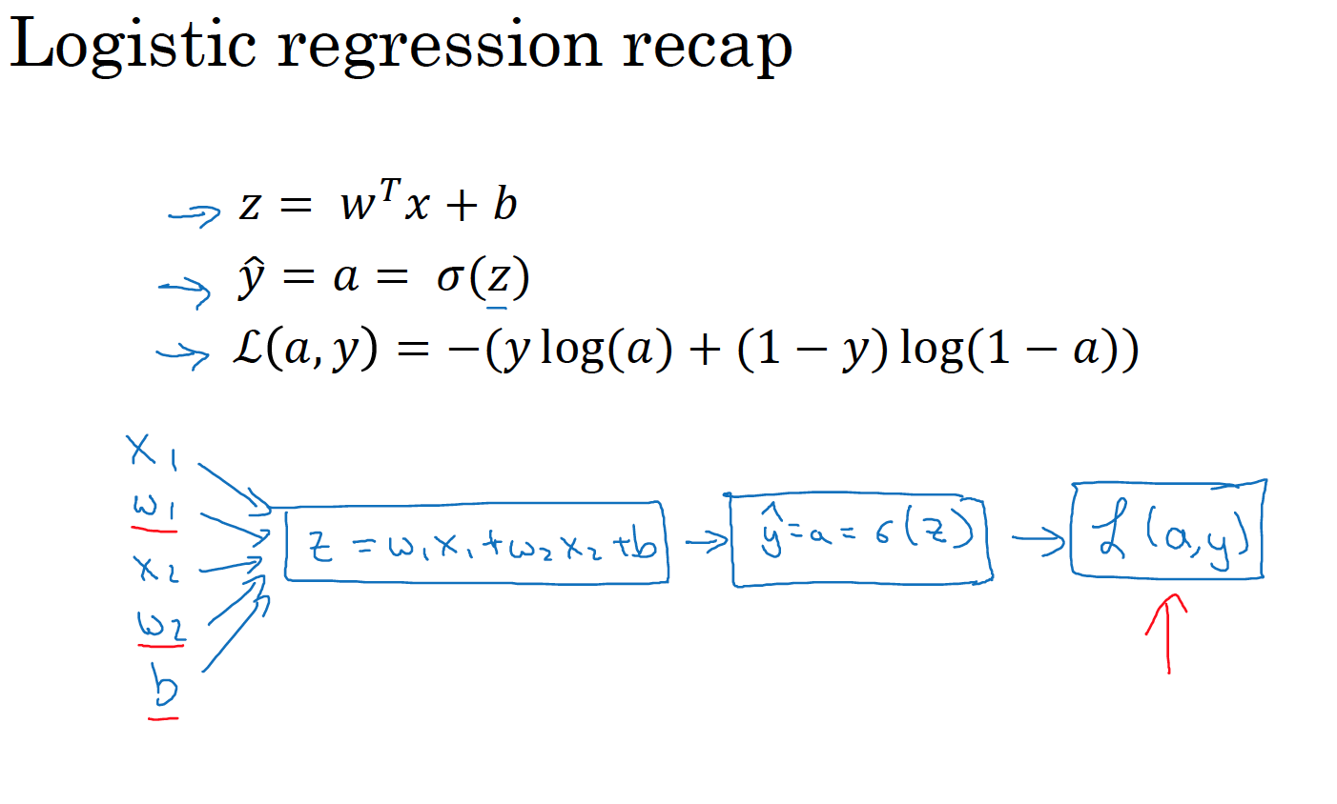

Slide 43
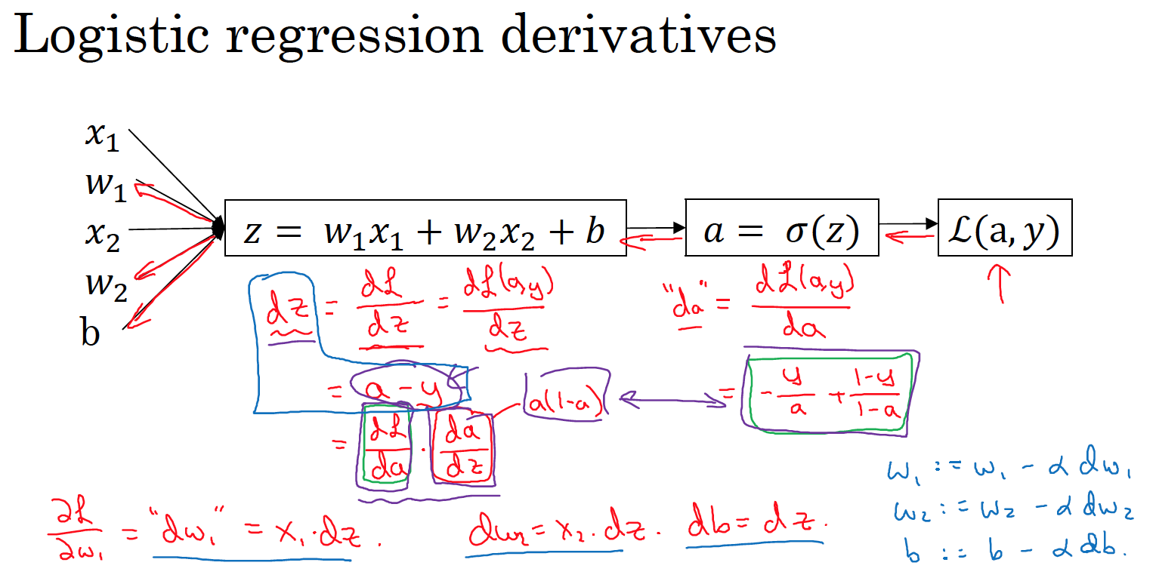

Slide 44
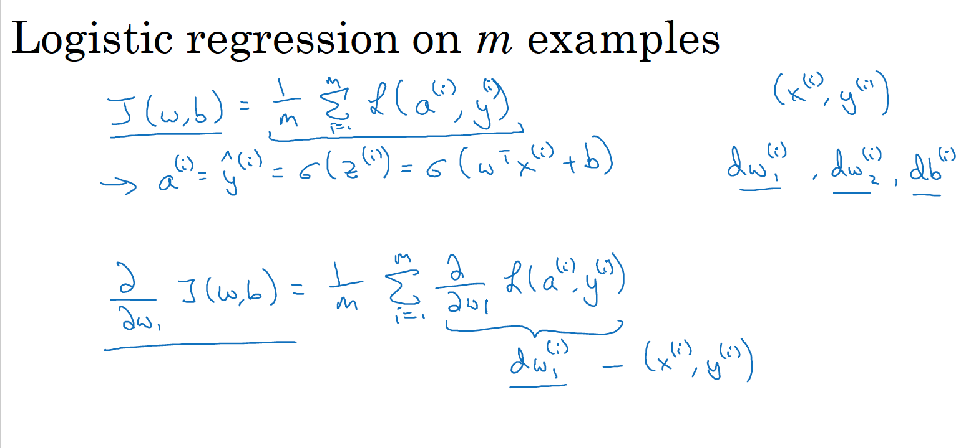

Slide 45
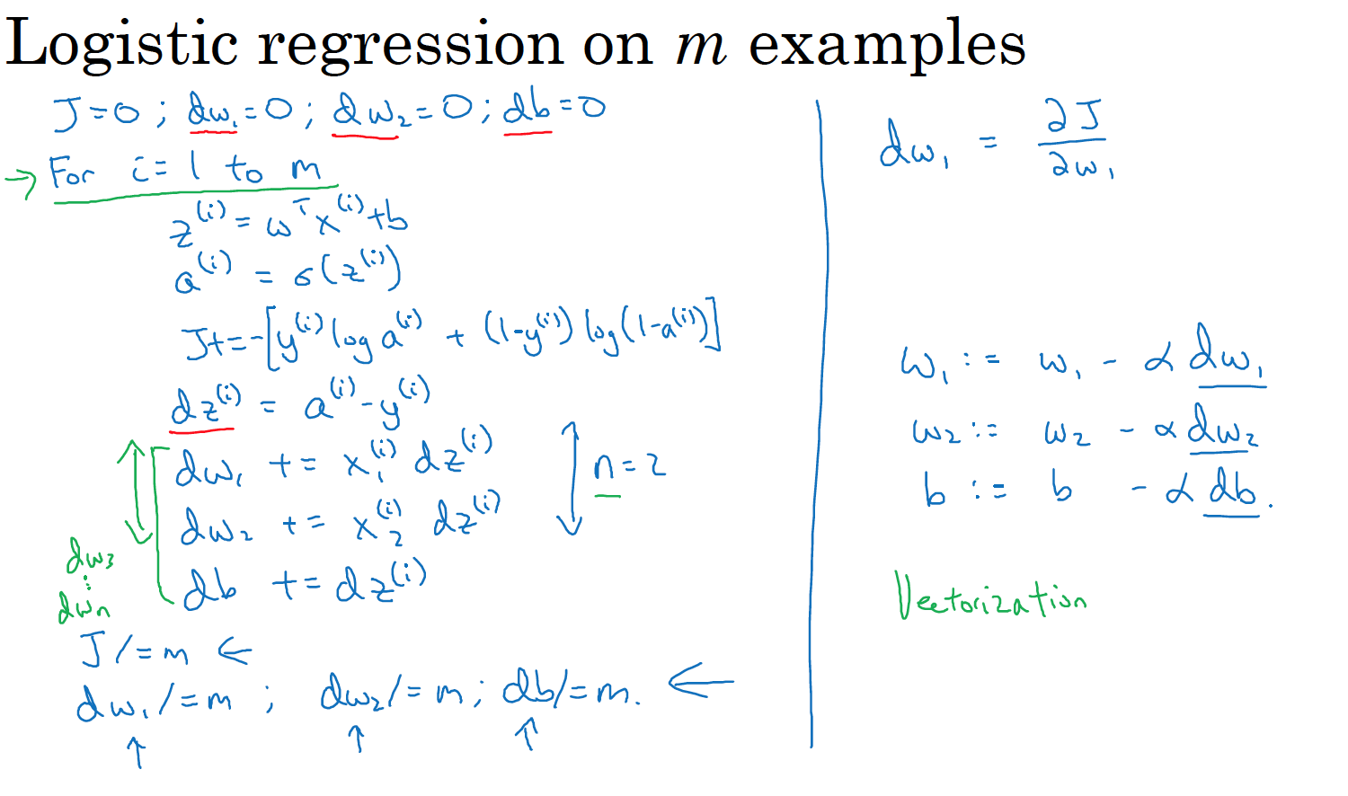

Slide 46
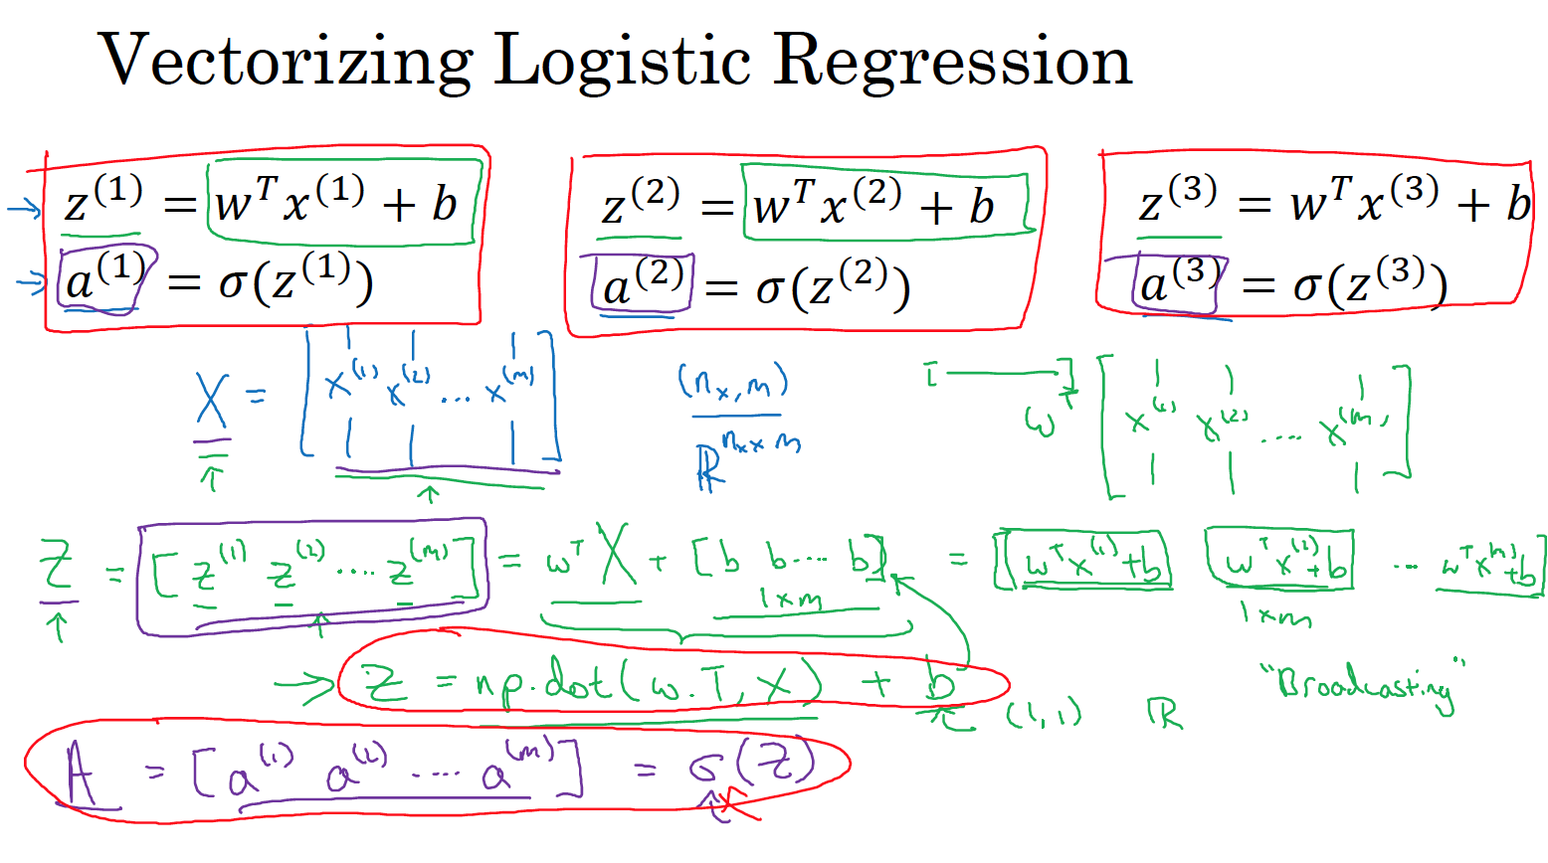

Slide 47
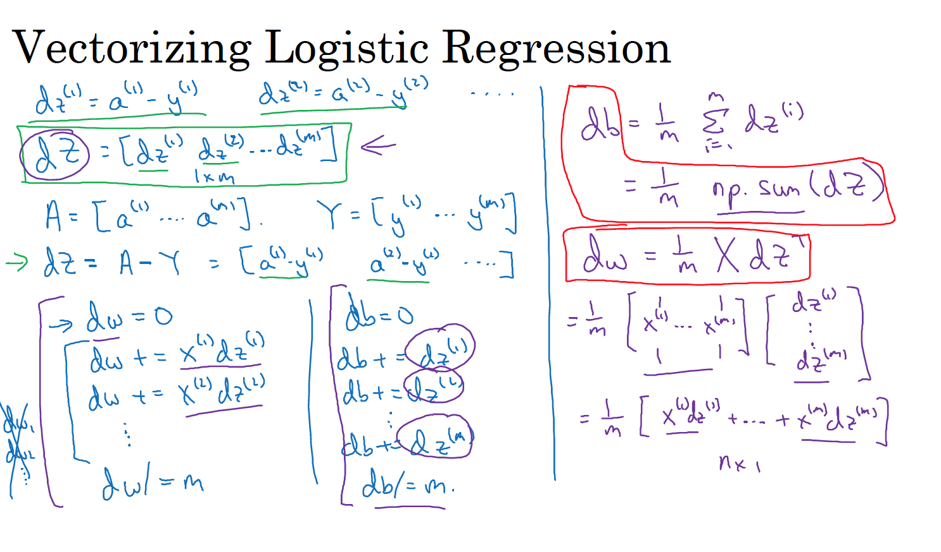

Slide 48
